Slide 1
Functional JavaScript
07-Apr-18 | Start
Appendix
Online

Slide 2
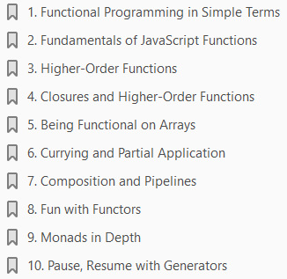
Ch | Date
1 | 09-Apr-18
2 | 12-Apr-18
3
4
5
6
7
8
Beginning Functional JavaScript 2017

Slide 3
Functional Programming in Simple Terms
1

Slide 4
Intro
Welcome to the functional programming world.
The world, which has only functions, living happily without any outside world dependencies, without states, without mutations – forever.
Functional programming is a buzz in recent days.
You might have heard about this term within your team, in your local group meeting, and have thought about this.
If you’re already aware of what that means, this is great! But for those who don’t know the term, don’t worry.
This chapter is for that purpose: to introduce you to Functional terms in simple English.
We are going to begin this chapter by asking a simple question: what is a function in Mathematics?
Then later on we are going to create a function in JavaScript with a simple example using our function definition.
The chapter ends by explaining the benefits that functional programming gives to our developers.

Slide 5

What Is Functional Programming? Why It Matters?
Before we begin to see what the functional programming term means , we have to answer another question: what is a function in mathematics?
A function in mathematics can be written like this:
The statement can be read like “A Function F, which takes X as its argument, and returns the output Y.”
X and Y can be any number, for instance.
That’s a very simple definition. But there are key takeaways in the definitions :
A function must always take an argument.
A function must always return a value.
A function should act only on its receiving arguments (i.e., X) not the outside world.
For a given X, there will be only one Y.
Functional programming techniques are heavily based on mathematical functions and its ideas.
We will be seeing the ideas of mathematical functions and how they are used in order to understand functional programming.

Slide 6
Functions in JavaScript
Imagine we have to write a function that does the tax calculation.
How are you going to do this in JavaScript?
We can implement such a function like this as shown in Listing 1-1:
One of the key points of our mathematical function term is that the function logic shouldn’t depend upon the outside world.
In our function calculateTax, we have made the function depend on the global variable percentValue.
Thus the above function we have created can’t be called as a real function in a mathematical sense.
The fix is very straightforward: we have to just move the percentValue as our function argument: Listing 1-2
Now our function calculateTax can be called as a real function.
But what have we gained?
We have just made the elimination of global variable access inside our calculateTax function.
Removing global variable access inside a function makes it easy for testing.
Now we have made our relationship with the Math function to our JavaScript function.
With this simple exercise, we can define functional programming in simple technical terms.

Slide 7
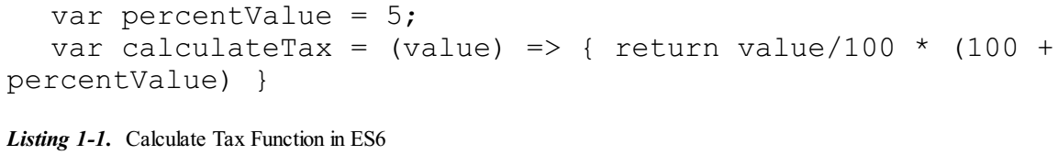
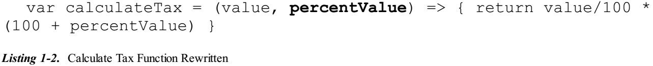
Listing 1-1 || 1-2

Slide 8
Definition of Functional Programming
Functional programming is a paradigm in which we will be creating functions that are going to work out its logic by depending only on its input.
This ensures that a function, when called multiple times, is going to return the same result.
The function also won’t change any data in the outside world, leading to cacheable and testable codebase.
There are two more important characteristics of Functional programing that are missing in the definition.
We are going to discuss them in detail in the upcoming sections before we dive into the benefits of functional programming.

Slide 9
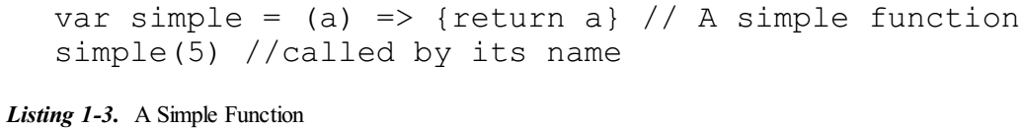
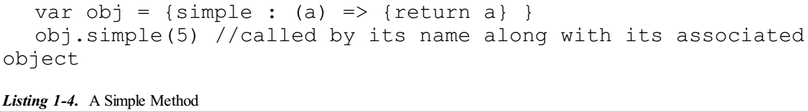
Functions vs Methods in JavaScript
A Function is a piece of code that can be called by its name.
It can be pass arguments and return values.
However, Method is a piece of code that must be called by its name along with its associated object name.
Example of a Function Listing 1-3:
Example of a Method Listing 1-4:

Slide 10

Referential Transparency
With our above definition of function, we have made a statement that all the functions are going to return the same value for the same input.
And this property of a function is called a Referential transparency.
We will take a simple example as shown in Listing 1-5:
In the above code snippet we have defined a simple function called identity.
This function is going to return whatever you‘re passing as its input; that is, if you’re passing 5, it’s going to return back the value 5 (i.e., the function is just acts as a mirror or identity).
Note that our function does operate only on the incoming argument ‘i’, and there is no global reference inside our function (remember in Listing 1-2, we removed ‘percentValue’ from global access and made it an incoming argument).
This function satisfies the conditions of Referential Transparency.

Slide 11

Substitution Model
Now imagine this function is used between other function calls like this:
With our Referential Transparency definition we can convert the above statement into this:
Now this process is called a Substitution model as you can directly substitute the result of the function as is (mainly because the function doesn’t depend on other global variables for its logic) with its value.
This leads to parallel code and caching.
Imagine that with this model, you can easily run the above function with multiple threads without even the need of synchronizing!
The reason for synchronizing comes from the fact that threads shouldn’t act upon global data when running parallel.
Functions that obey Referential Transparency are going to depend only on inputs from its argument; hence threads are free to run without any locking mechanism!

Slide 12
Caching
Since the function is going to return the same value for the given input, we can, in fact cache it!
For example, imagine there is a function called ‘factorial’, which calculates the factorial of the given number.
‘Factorial’ takes the input as its argument for which the factorial needs to be calculated.
We all know the ‘factorial’ of ‘5’ going to be ‘120’.
What if the user calls the ‘factorial’ of ‘5’ a second time? If the ‘factorial’ function obeys Referential transparency, we know that the result is going to be ‘120’ as before (and it only depends on the input argument).
With this characteristic in mind, we can cache the values of our ‘factorial’ function.
Thus if a ‘factorial’ is called for the second time with the input as ‘5’, we can return the cached value instead of calculating once again.
Here you can see how a simple idea helps in parallel code and cacheable code.

Slide 13
Imperative, Declarative, Abstraction
Functional programming is also about being declarative and writing abstracted code.
We all know and have worked on N imperative paradigm.
We’ll take a problem and see how to solve it in an imperative and declarative fashion.
Suppose you have a list or array and want to iterate through the array and print it to the console.
The code is shown in Listing 1-6. It works fine.
But in the above approach to solve our problem, we are telling exactly “how” we need to do it.
For example, we have written an implicit for loop with an index calculation of the array length and printing the items.
It looks like we are telling the compiler what to do.
In this case, we are telling “Get Array Length, Loop our array, Get each Element of array using index etc.”
We call it an “imperative” solution. Imperative programming is all about telling the compiler “how” to do the things.

Slide 14
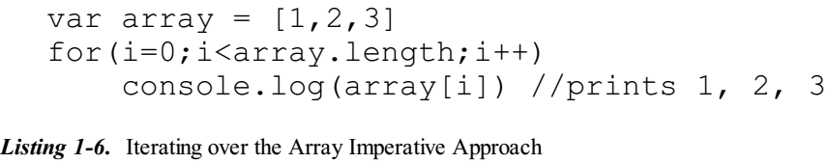
Listing 1-6

Slide 15
Declarative Programming
In Declarative programming , we are going to tell “what” the compiler needs to do rather than the “how” parts.
The “how” parts are being abstracted into common functions (these functions are called as Higher-Order functions).
Now we can use the in-built forEach function to iterate the array and print it Listing 1-7.
The above code snippet does print exactly the same output in the previous Listing 1-6.
But here we have removed the “how” parts like “Get Array Length, Loop our array, Get each Element of array using index, etc.”
We have used an abstracted function, which takes care of “how” part, leaving us the developers to worry about our problem in hand (“what” part).
Functional programming is about creating functions in an abstracted way, which can be reused by other parts of the code.

Slide 16
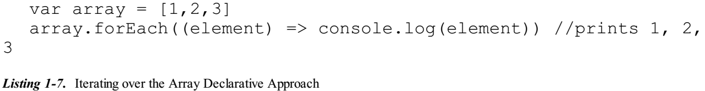
Listing 1-7

Slide 17
Functional Programming Benefits
We have seen the definition of functional programming and a very simple example of a function in the JavaScript language.
This section will help you see through the lenses and see the huge benefits that functional programming is opting to offer us!
Most of the benefits of Functional programming come from writing Pure Functions.
So before we see the benefits of Functional programming, we will see what a pure function is.

Slide 18

Pure Functions
Pure functions are the functions that return the same output for the given input.
Take an example as given in Listing 1-8:
The above function ‘double’ is a pure function just because given an input, it is going to always return the same output.
Calling the double function with input 5 always gives back the result as 10!
Pure functions obey Referential transparency.
Thus we can replace double(5) with 10, without any hesitations.
The benefits of Pure functions are:
Pure Functions Lead to Testable Code
Reasonable Code
Parallel Code

Slide 19
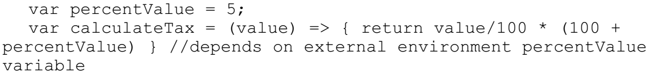
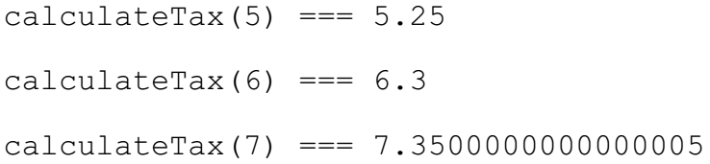
Pure Functions Lead to Testable Code
Functions that are not pure have side effects.
Consider our previous tax calculation example (Listing 1-1):
The function calculateTax is not a pure function, mainly because for calculating its logic it depends on the external environment.
However, the function works but the function is very tough to test! Let’s see the reason for this.
Imagine we are planning to run a test for our calculateTax function three times for three different tax calculations.
We set up the environment like this:

Slide 20
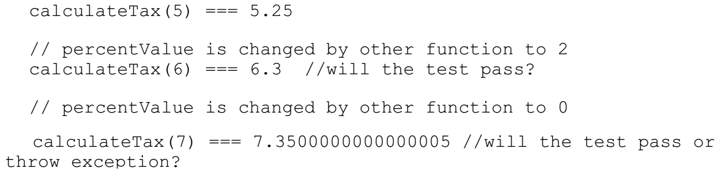
Pure Functions Lead to Testable Code |
The entire test passes! But hold on, since our original calculateTax function depends on the external environment variable percentValue, things can go wrong.
Imagine the external environment is changing the variable percentValue while you are running the same test cases:
As you can see here the function is very hard to test.
However we can easily fix the issue, by removing the external environment dependency from our function, leading the code to this:

Slide 21
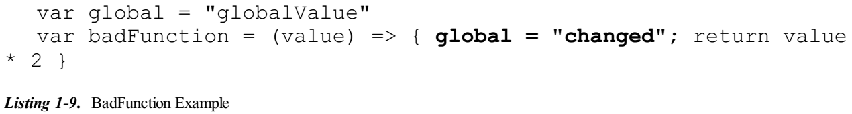
Property of Pure Function
“Pure Function also shouldn’t mutate any external environment variables.”
In other words, the pure function shouldn’t depend on any external variables (like shown in the example) and also change any external variables.
Let’s take a quick look what we meant by changing any external variables. For example, consider the following code in Listing 1-9:
When ‘badFunction’ function is called it changes the global variable ‘global’ to value ‘changed’.
Imagine another function that depends on ‘global’ variable for its business logic!
Calling ‘badFunction’ affects other functions’ behavior.
Functions of this nature (i.e., functions that have side effects) make the code base hard to test.
Apart from testing, these side effects will make the system behavior very hard to predict in case of debugging!

Slide 22
Reasonable Code
As developers we should be good at reasoning about the code or a function.
By creating and using Pure functions we can achieve that very simply.
To make this point clearer, we are going to use a simple example of function double (from Listing 1-8):
By looking at this function name we can easily reason that this function doubles the given number and nothing else!
In fact, using our Referential transparency concept, we can easily go ahead and replace the double function call with the corresponding result!
Developers spend most of their time in reading others’ code.
Having a function with side effects in your code base is hard to read for other developers in your team.
Code base with pure functions are easy to read, understand, and test.
Remember that a function (regardless if it’s pure function) must always have a meaningful name.
With that said, you can’t name function ‘double’ as ‘dd’ given what it does.

Slide 23
Parallel Code
Pure function allows us to run the code in parallel.
As pure function is not going to change any of its environments, this means we do not need to worry about the synchronizing at all!
Of course JavaScript doesn’t have real threads to run the functions in parallel, but what if your project uses WebWorkers for running multiple things in parallel? Or a server-side code in node environment that runs the function in parallel?
For example, imagine we have the following code as given in Listing 1-10:
What if we need to run both ‘function1’ and ‘function2’ in parallel? Imagine thread one (T-1) picks ‘function1’ to run.
Thread two (T-2) picks ‘function’ to run. Now both threads are ready to run and here comes the problem. What if T-1 runs before T-2?
Since both functions (‘function1’ and ‘function2’) depend on global variable ‘global’, running these functions in parallel causes undesirable effects.
Now change these functions into a pure function as explained in Listing 1-11: Here we have moved ‘global’ variable as arguments for both the functions making them pure.
Now we can run both functions on parallel without any issues. Since the functions don’t depend on an external environment (‘global’ variable), we aren’t worried about thread execution order as with Listing 1-10.

Slide 24
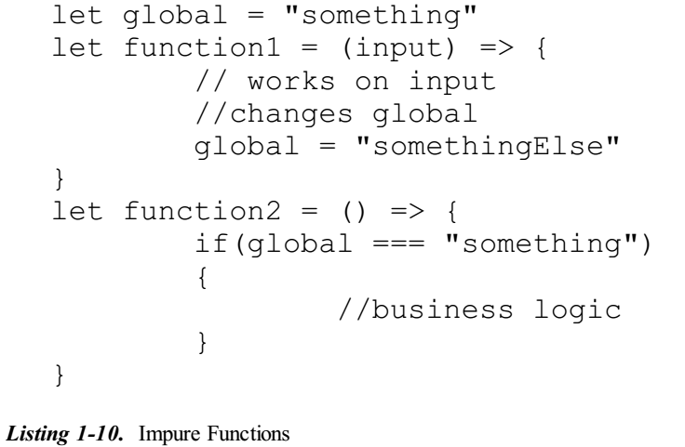
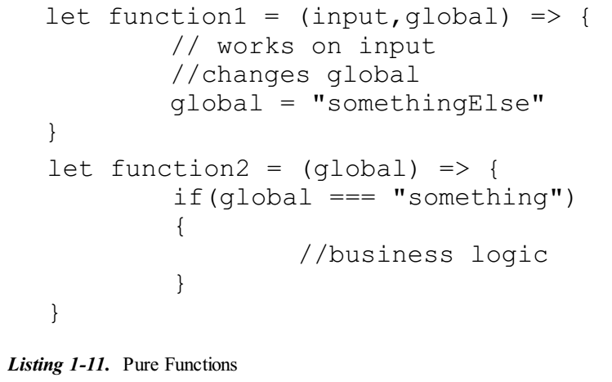
Listing 1-10 || 1-11

Slide 25
Cacheable
Since the pure function is going to always return the same output for the given input, we can cache the function outputs.
To make this more concrete, we can take a simple example. Imagine we have a function that does do time-consuming calculations.
We will name this function longRunningFunction:
If longRunningFunction function is a pure function, then we know that for the given input, it’s going to return us the same output!
Now with that point in mind, why do we need to call the function again with its input multiple times?
Can’t we just replace the function call with the function’s previous result? (Again note here how we are using the referential transparency concept, thus replacing the function with the previous result value and leaving the context unchanged).

Slide 26
Cacheable objects
Imagine we have a bookkeeping object, which does keep all the function call results of longRunningFunction like this:
The longRunningFnBookKeeper is a simple JavaScript object, which is going to hold all the input (as keys) and outputs (as values) in it as a result of invoking longRunningFunction functions.
Now with our pure function definition in place, we can check if the key is present in longRunningFnBookKeeper before invoking our original function, like what is shown in Listing 1-12:
The code is relatively straightforward. Before calling our real function, we are checking if the result of that function with the corresponding ip is in the bookkeeping object.
If yes, we are returning it, or else we are calling our original function and updating the result in our bookkeeping object as well.
Did you see how easily we have made the function calls cacheable by using less code? That’s the power of pure functions!
We will be writing a functional lib, which does the caching, or technical memorization, of our pure function calls later in the book!

Slide 27
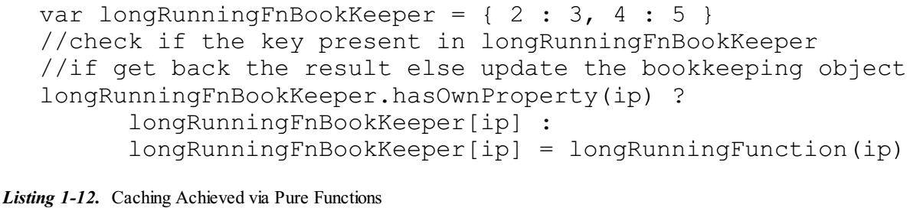
Listing 1-12

Slide 28
Pipelines and Composable
With pure functions we are going to do only one thing in that function.
We have seen already how the pure function is going to act as a self-understanding of what that function does by seeing its name.
Pure functions should be designed in such a way that it should do only one thing.
Doing only one thing and doing it perfectly is a UNIX philosophy; we will be following the same while implementing our pure functions.
There are many commands in UNIX and LINUX platforms, which we are using for day-to-day tasks.
For example, we use cat to print the contents of the file, grep to search the files, wc to count the lines, etc.
These commands do solve one problem at a time.
But we can compose or pipeline to do the complex tasks.
Imagine we want to find a specific name in a text file and count its occurrences.
How we will be doing that in our command prompt?
The command looks like this:

Slide 29
Pipelines and Composable |
The above command does solve our problem via composing many functions.
Composing is not only unique to UNIX/LINUX command lines, but they are the heart of the Functional programming paradigm.
We call them Functional Composition in our world.
Imagine these same command lines have been implemented in JavaScript functions.
We can use them with the same principles to solve our problem!
Now think about another problem in a different way to solve.
You want to count the number of lines in text.
The commands are in fact a pure function with respect to our definition.
It takes an argument and returns the output to the caller without affecting any of the external environments.

Slide 30
Pure Function Is a Mathematical Function
In the section “Cacheable” we saw a code snippet (Listing 1-14):
The objective was to cache the function calls. We did so by the bookkeeping object.
Imagine we have called the longRunningFunction many times so that our longRunningFnBookKeeper grows into the object, which can be seen in Listing 1-13.
Now imagine that longRunningFunction input ranges only from 1-11 integers (just for an example).
And since we have already built the bookkeeping object for this particular range, we can refer only the longRunningFnBookKeeper to say the output longRunningFunction for the given input.
Let’s analyze this bookkeeping object.
This object gives us the clear picture that our function longRunningFunction does takes a input and maps over the output for the given range (in this case it’s 1-11).
And the important point to note over here is that the inputs (in this case, the keys) have, mandatorily, a corresponding output (in this case, the result) in the object.
And also there is no input in the key section that maps to two outputs!

Slide 31
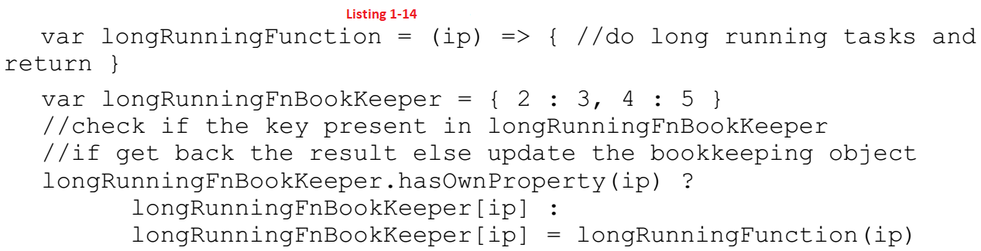
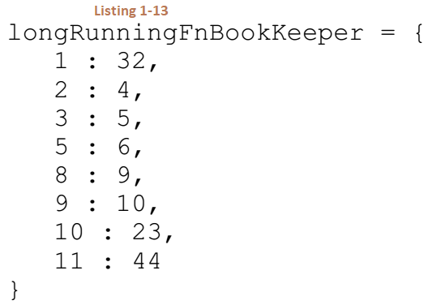
Listing 1-13 || 1-14

Slide 32
Domain and Codomain
In mathematics, a function is a relation between a set of inputs and a set of permissible outputs with the property that each input is related to exactly one output.
The input to a function is called the argument and the output is called the value.
The set of all permitted inputs to a given function is called the domain of the function, while the set of permissible outputs is called the codomain.
The above definition is exactly the same as our Pure functions! Have a look at our longRunningFnBookKeeper object.
With this very simple example you can easily see how the Mathematical Function idea is borrowed into Functional paradigm world (as I stated in the beginning of the chapter).

Slide 33
What We Are Going to Build
We have talked a lot about functions and functional programming in this chapter.
With this fundamental knowledge we are going to build the functional library called ES6-Functional.
This library will be built chapter by chapter throughout the text.
By building the functional library you will be exploring how JavaScript functions can be used (in a functional way) and also at the same time how functional programming can be applied in day-to-day activities (using our created function to solve the problem in our code base)!

Slide 34

Is JavaScript a Functional Programming Language?
Before we close this chapter, we have to take a step back and answer a fundamental question. Is JavaScript a functional programming language?
The answer is yes and no.
We said in the beginning of the chapter that functional programming is all about functions, which have to take at least an argument and return a value.
But to be frank we can create a function in JavaScript that can take no argument and in fact return nothing.
For example, the below code is a valid code in the JavaScript engine:
The above code will execute without any error in the JavaScript world!
The reason is that being JavaScript is not a pure functional language (like Haskell) but rather a Multi-paradigm language.
However the language is very much suitable for the functional programming paradigm as discussed in this chapter.

Slide 35
Is JavaScript a Functional Programming Language? |
The techniques and the benefits that we have discussed up to now can be applied in pure JavaScript! And that’s the reason for this book’s title!
JavaScript is a language that has a support for
Function as arguments
passing functions to another functions, etc. –
mainly because JavaScript treats functions as its first-class citizens (we will talk more about this in upcoming chapters).
Because of the constraints according to the definition of the term function, we as developers need to take them into account while creating them in the JavaScript world.
By doing so, we will gain many advantages from the functional paradigm as discussed in this chapter.

Slide 36
Fundamentals of JavaScript Functions
2

Slide 37
Intro
In this chapter we are going to see how functions in JavaScript can be used.
We will be looking at the latest JavaScript version ES6.
This chapter will be a refresher on how to
create functions,
call them, and
pass arguments
in ES6 but not explaining all the features of ES6.
I strongly recommend you to try all the code snippets in the book to get a gist of how to use ES6 functions (more precisely we will be working on arrow functions ).
Once we have a solid understanding of how to use functions, we will be turning our focus onto seeing how to run the ES6 code in our system.
As of today, browsers don’t support all features of ES6. In order to tackle that, we will be using a tool called Babel.
At the end of the chapter we will be starting our groundwork on creating a functional library.
For this purpose we will be using a node project that will be set up using Babel-Node tool to run our ES6 codes in your system!

Slide 38
ECMAScript A Bit of History
ECMASCRIPT is a specification of JavaScript, which is maintained by Ecma International in ECMA-262 and ISO/IEC 16262.
There are three versions of ECMASCRIPT; to be more specific they are shown in Listing 2-0:
We will be referring to ECMAScript as ES6 in this book. So these terms are interchangeable.

Slide 39
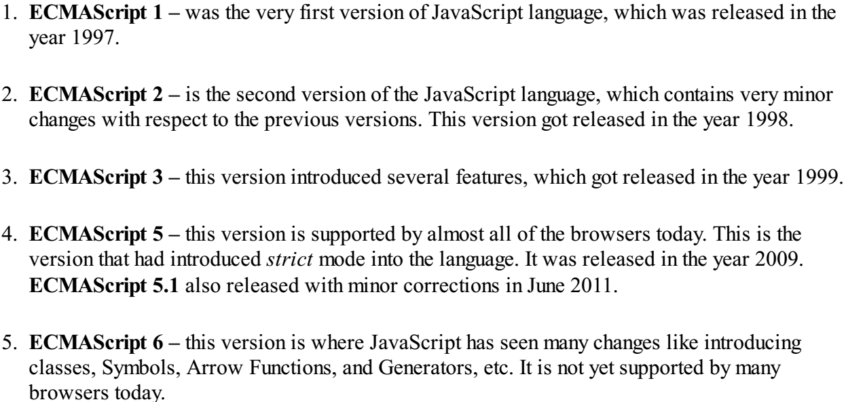
Listing 2-0

Slide 40
Creating and Executing Functions
In this section we are going to see how to create and execute functions in several ways in ES6.
Since many browsers do not yet support ES6 today, we want to find a way to run ES6 code smoothly.
Meet Babel.
Babel is a transpiler , which can convert ES6 code into valid ES5 code (note that in our history section, we mentioned ES5 code can be run in all browsers today).
By converting the code into ES5 the developers have a way of seeing and using the features of ES6 without any problem.
Using Babel, we can run all the code samples that are presented in this book.
Installation of Babel is covered in Appendix A. Kindly refer to this appendix and install Babel before we begin.
Now having installed Babel, let’s get our hands dirty by seeing our first simple function in ES6.

Slide 41

First Function
We will define our first simple function in ES6.
The simplest function one can write in ES6 is as follows (Listing 2-1):
If you try to run this function in babel-repl, you can see the result as:
Let’s split them as show in Listing 2-1A.
In ES6 we can skip the function keyword to define functions.
You can see we have used => operator to define the function body.
Functions created this way in ES6 are called Arrow Functions . We will be using Arrow functions throughout the book.
Now that the function is defined, we can execute it to see the result.
The function we have created doesn’t have a name. Then how do I call it?
Functions that don’t have names are called Anonymous functions.
We will understand the usage of anonymous functions in the functional programming paradigm, when seeing Higher Order functions in the next chapter.

Slide 42
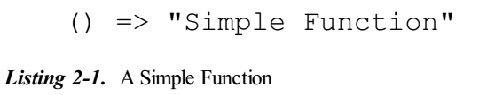
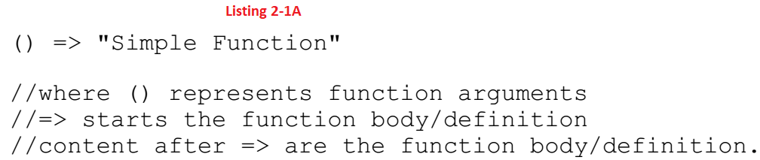
Listing 2-1 || 2-1A

Slide 43
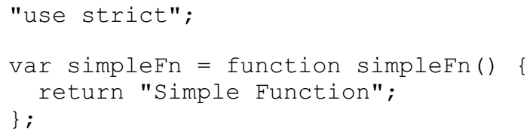
Using Functions
Let’s assign a name for it as shown in Listing 2-2:
Since we now have access to the function simpleFn we can use this reference to execute the function as shown in Listing 2-2A.
We have created a function and also executed it in ES6.
We can see how the same function looks alike in ES5.
We can use babel to convert our code into ES5, using the following command:
This will generate the file called the script-compiled.js in your current directory.
Now open up the generated file in your favorite editor:
That’s our equivalent code in ES5!

Slide 44
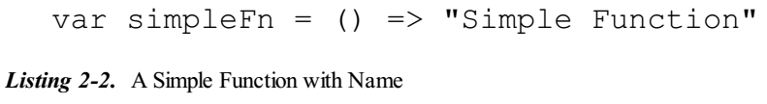
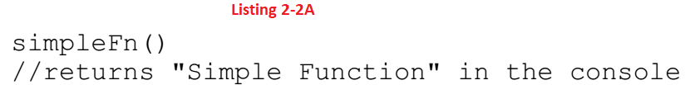
Listing 2-2 || 2-2A

Slide 45
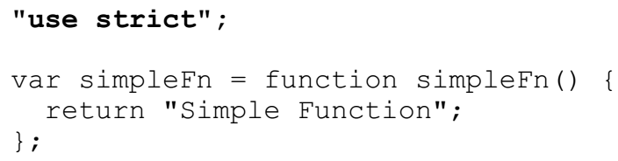
Strict Mode
In this section we will discuss “Strict Mode” in JavaScript.
We’ll see its benefits and why one should prefer “Strict Mode.”
You can see that the converted code runs in the strict mode, as shown here.
Strict modes have nothing to do with ES6, but discussing them here is the right choice.
As we have already discussed in the ECMAScript History section, strict mode was introduced to the JavaScript language at ES5.
Simply put, strict mode is a restricted variant of JavaScript.
The same JavaScript code that is running in strict mode can be semantically different from the code, which is not using strict.
All the code snippets, which don’t add the use strict in their js files, are going to be in non-strict mode.

Slide 46
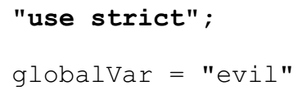
Strict Mode |
There are many advantages of using strict mode style in the world of JavaScript.
One simple thing is if you are defining a variable in global state (i.e., without specifying var command) like this:
In strict mode it’s going to be an error! That’s a good catch for our developers, because global variables are evil in JavaScript!
However if the same code were run in non-strict mode, then it wouldn’t have complained about the error!
Now as you can guess, the same code in JavaScript can produce different results whether you’re running in strict or non-strict mode.
Since strict mode is going to be very helpful for us, we will leave Babel to use strict mode while transpiling our ES6 codes.
We can place use stricts in either the beginning of your JavaScript file, in which case it’s going to apply its check for the full functions defined in the particular file.
Or else you can use strict mode only to specific functions. In that case, strict mode will be applied only to that particular function, leaving other function behaviors in non-strict mode.

Slide 47
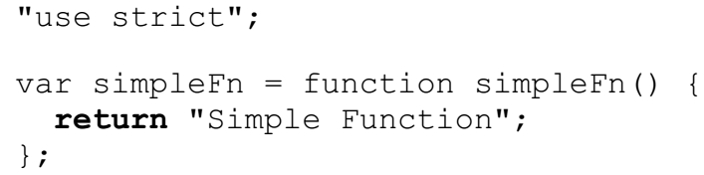
Return Statement is Optional
In ES5 converted code snippet, we saw that Babel adds the return statement in our simpleFn.
Where as in our real ES6 code, we didn’t specify any return statement:
Thus in ES6, if you have a function with only a single statement then it implicitly means that it returns the value.
What about multiple statement functions? How we are going to create them in ES6?

Slide 48
Multiple Statement functions
Now we are going to see how to write multiple statement functions in ES6. Let’s make our simpleFn a bit more complicated as follows in Listing 2-3.
Run the above function, and you will get the same result as before.
But here we have used the multiple arguments to achieve the same behavior.
Apart from that, you could notice that we have used let a keyword define our value variable.
The let keyword is new to the JavaScript keyword family. The let keyword allows you to declare variables that are limited to a particular scope of block!
This is unlike the var keyword that defines the variable globally to a function regardless of the block in which it’s defined.
To make the point concrete, we can write the same function with var and the let keyword, inside an if block as shown in Listing 2-4.
As you can see from the output, the variable declared via let keyword is accessible only within the if block not outside the block.
JavaScript throws the error when we access the variable a variable outside the block!
But whereas the variable declared with var when doesn’t act that way. Rather, it declares the variable scope for the whole function.

Slide 49
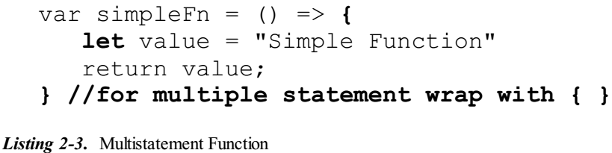
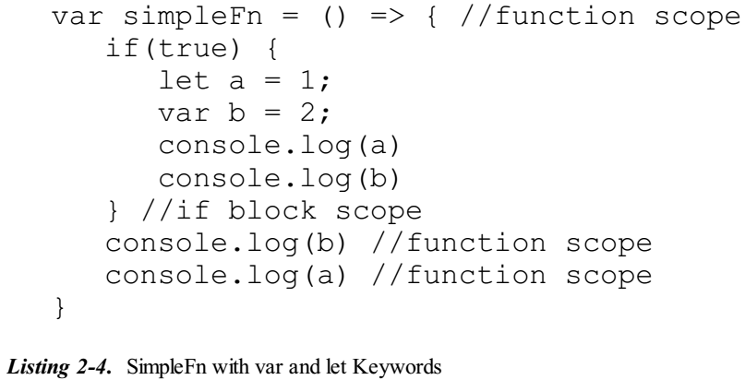
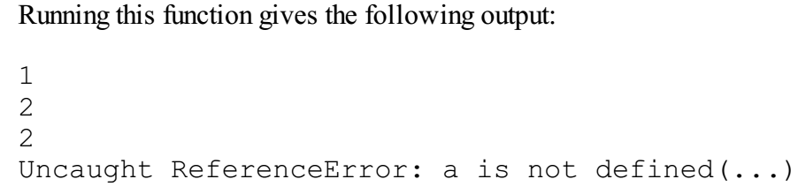
Listing 2-3 || 2-4

Slide 50

Function Arguments
Creating functions with arguments is the same as in ES5.
Look at a quick example as follows (Listing 2-5):
Here we create a function called identity, which takes value as its argument and returns the same.
As you can see, creating functions with arguments are the same as ES5; only the syntax of creating the function is changed.

Slide 51
ES5 Functions Are Valid in ES6
Before we close this section, we need to make an important point clear.
The functions that were written in ES5 are still valid in ES6!
It’s just a small matter that ES6 has introduced Arrow functions, it but doesn’t replace the old function syntax or anything else.
However we will be using ES6 functions throughout this book to showcase the functional programming approach.

Slide 52
Setting Up Our Project
After having an understanding of how to create Arrow functions in ES6 , we will shift our focus onto project setup in this section.
We are going to set up our project as a node project and at the end of the section, we will be writing our first Functional Function.
Make sure you have installed node and npm by following Appendix A.

Slide 53

Appendix A
Install Node In Your System
Installing Dependencies: In node , we will install the dependencies via npm.
npm will be part of your installation.
Run the following command to install babel :
Run the following command to install babel-node :
Note that -g will install the scripts globally.

Slide 54

Initial Setup
In this section, we will be following a simple step-by-step guide to set up our environment.
The steps are as follows:
The first step is to create a directory where our source code is going to be. Create a directory and name it whatever you want.
Go into that particular directory and run the following command from your terminal:
After running step 2, it will be asking you a set of questions; you can provide the value you want. Once it’s done, it will create a file called pacakage.json in your current directory.
The project package.json that I have created looks like this as shown here in Listing 2-6:
Now we need to add a few libraries, which will allow us to write ES6 code and execute them.
Run the following command in the current directory:

Slide 55
Initial Setup |
The above command downloads the babel package called ES2015-Node5; the main aim of this package is to allow ES6 code to run on Node Js platform.
The reason is that Node Js, at the time of writing this book; is not fully compatible with ES6 features.
Once the above command is run, you will be able to see a folder called node_modules created in the directory, which has the babel-preset-es2015-node5 folder.
Since we have used --save-dev while installing, npm does add the corresponding babel dependencies to our package.json.
Now if you open your package.json, it should look like the Listing 2-7:
Now that this is in place, we can go ahead and create two directories called lib and functional-playground. So now your directory looks like Listing 2-7A .
Now we are going to put all our functional library code into lib and use functional-playground to play and understand our functional techniques.

Slide 56
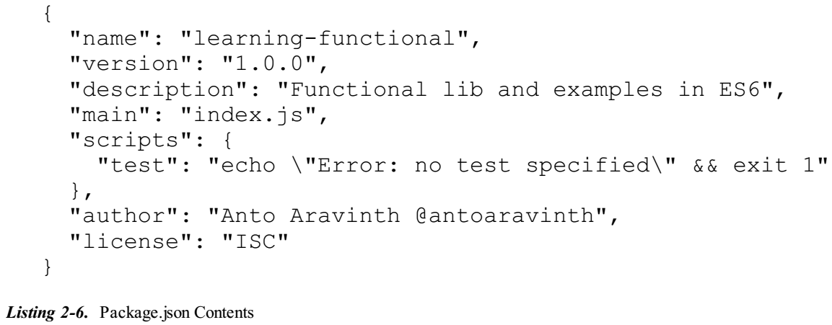
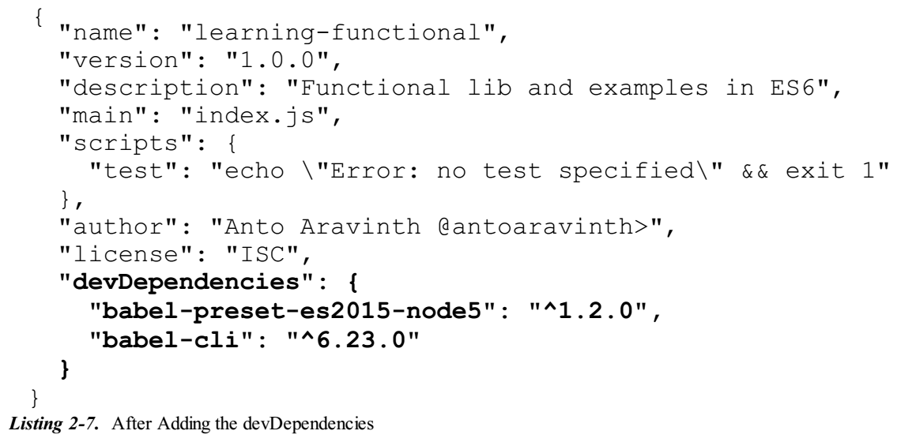
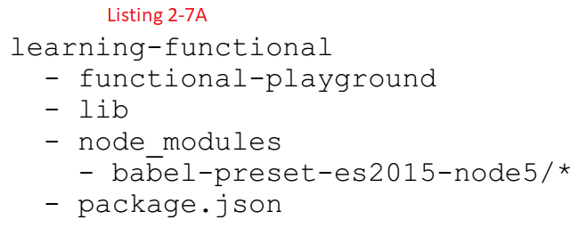
Listing 2-6 || 2-7 || 2-7A

Slide 57
Our First Functional Approach to the Loop Problem
Imagine we have to iterate through the array and print the data to the console.
How do we achieve this in JavaScript? (Listing 2-8)
As we have already discussed in Functional Programming in Simple Terms, Chapter 1, abstracting the operations into functions is one of the pillars of functional programming.
So let’s go and abstract this operation into function, so that we can reuse it any time we need to rather than repeating ourselves in telling “how” to iterate the loop.
Create a file called es6-functional.js in lib directory.
Our directory structure looks like Listing 2-8A.
Now with that file in place, go ahead and place the below content into that file (Listing 2-9).
You might notice that we have started with a keyword const for our function definition.
This keyword is part of ES6, which makes the declaration constant.
For example, if someone tries to reassign the variable with the same name like this:

Slide 58
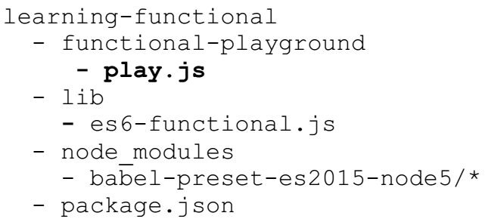
Our First Functional Approach to the Loop Problem |
The above code will throw an error like this:
This will prevent it from being accidently reassigned! Now we’ll go and use the above created function to print all the data of the array to the console.
In order to do that, create a file called play.js function in functional-playground directory.
So now the current file looks like:
We will call the forEach in our play.js file. But how are we are going to call this function, which resides in a different file?

Slide 59
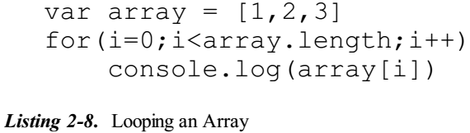
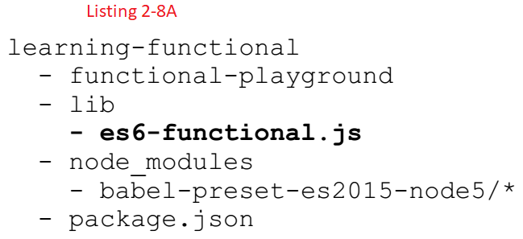
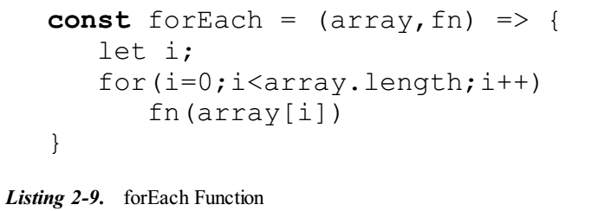
Listing 2-8 || 2-8A || 2-9

Slide 60
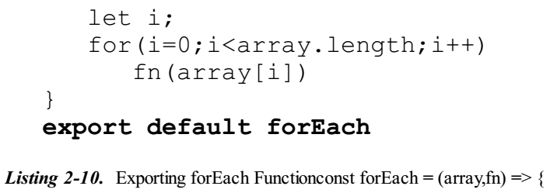
Gist on Exports
ES6 also introduced the concept called modules.
ES6 modules are stored in files.
In our case we can think of es6-functional.js file itself as a module.
Along with the concept of modules came imports and exports statements.
In our running example, we have to export the forEach function so that others can use them.
So that we can change the following code into in our es6-functional.js file.

Slide 61
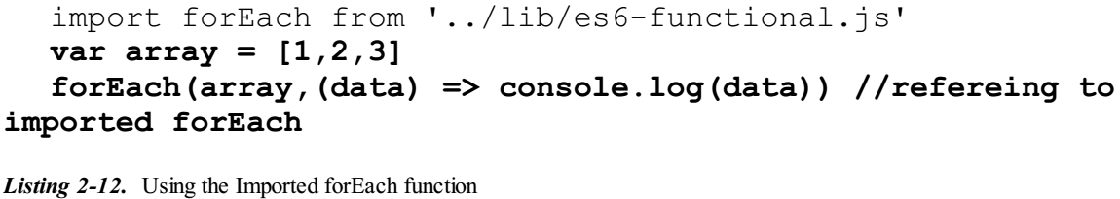
Gist on Imports
Now that we have exported our function as you can see in Listing 2-10, let’s go and consume it via import!
Open the file play.js and add the following into it as shown in Listing 2-11:
The above line tells JavaScript to import the function called forEach from es6- functional.js.
Now the function is available to the whole file with the name forEach.
Now add the code into play.js like this as shown here in Listing 2-12:

Slide 62

Running the Code Using Babel-Node
Let’s run our play.js file.
Since we are using ES6 in our file, we have to use Babel-Node to run our code.
Babel-Node is used to transpile our ES6 code and run it on Node js.
It should be installed along with babel-cli. It will be available in the terminal, only if you have installed babel-cli globally.
So from our project root directory, we can call the babel-node like this:
The above command tells us that our play.js file should be transpiled with es2015-node5 and run into node js. This should give the output as follows:
Imagine you want to iterate and print the array contents with multiples of 2. How will we do it? Super simple – reuse our forEach:
which will print the output as expected!

Slide 63

Creating Script in Npm
We have seen how to run our play.js file.
But it’s lot to type! Each time we need to run the following:
Rather than this, we can bind the following command to our npm script. We will change the package.json accordingly – Listing 2-13
Now we have added the babel-node command to scripts. So we can run our playground file (node functional-playground/play.js) as follows:
which will run the same as before.

Slide 64
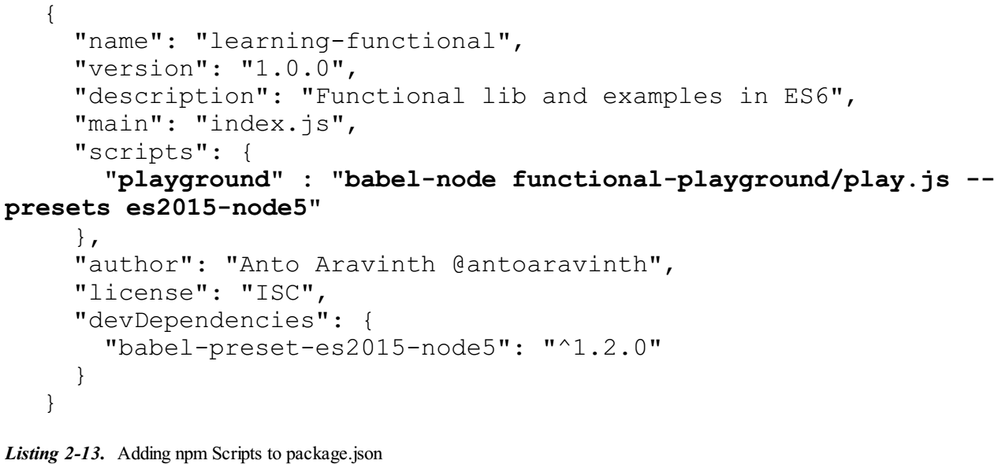
Listing 2-13

Slide 65
Running the Source Code from Git
Whatever we are discussing in the chapter will go into a git repository ( https://github.com/antoaravinth/functional-es6 ).
You can clone them into your system using git like this:
Once you clone the repo, you can move into a specific chapter source code branch.
Each chapter has its own branch in the repo.
For example, in order to see the code samples used in Chapter 2, then you need to do this:
Once you check out the branch, you can run the playground file as before!

Slide 66
Higher-Order Functions
3

Slide 67
Intro
In the previous chapter we saw how to create simple functions in ES6.
We also set up our environment to play around with functional programs using node ecosystem.
In fact, we have created our first functional program API called forEach in the previous chapter.
There is something special about the forEach function that we have developed in Chapter 2.
We passed a function itself as an argument to our forEach function.
There is no trick involved there; it’s part of JavaScript specification that a function can be passed as an argument.
JavaScript as a language treats functions as data. This is a very powerful concept that allows us to pass functions in place of data.
A function that takes another function as its argument is called a Higher-Order function .
We are going to see Higher-Order functions (HOC for short) in this chapter in depth.
We will be starting the chapter with a simple example and definition of HOC.
Later we will be moving to see more real-world examples of how HOC can help a programmer to solve complex problems easily.
As before, we will be adding the HOC functions that we are creating in the chapter in our library.

Slide 68
Understanding Data
As programmers we know our programs act on data.
Data is something that is very important for the consumption of our written program to execute.
Hence almost all programming languages give several data for the programmer to work with.
For example, we can store the name of a person in String data type.
JavaScript offers several data types that we will be seeing in the next subsection.
At the end of the section, we will be introduced to a solid definition of higher-order functions, with simple and concise examples.

Slide 69
Understanding JavaScript Data Types
Every programming language has data types.
These data types can hold data and allow our program to act upon it.
In this little section, we will be seeing JavaScript's data types.
In a nutshell, JavaScript as a language supports the following data types:
Numbers Strings
Booleans Objects
Null undefined
functions
Since functions are data types like String, we can pass them around, store them in a variable, etc., similar to String and Numbers data types
Functions are First Class Citizens when the language permits them to be used as any other data type, that is, functions can be assigned to variables, passed around as arguments, and can be returned from other functions.
In the next section we will see a quick example of what we mean by storing and passing functions around.

Slide 70



Storing a Function
As mentioned in the previous section, functions are nothing but data. Since it’s data, we can hold them in a variable!
The Listing 3-1 is literally a valid code in JavaScript context.
In the above code snippet, fn is nothing but a variable that is pointing to a data type function.
We can quickly check that fn is of type function by running the following:
Since fn is just a reference to our function, we can call it like this:
the above will execute the function that fn points to.

Slide 71
Passing a function

Slide 72
Returning a function

Slide 73
Abstraction and Higher-Order Functions

Slide 74
Abstraction Definitions

Slide 75
Abstraction via Higher-Order Functions

Slide 76
Higher-Order Functions in the Real World

Slide 77
every Function

Slide 78
some Function

Slide 79
sort Function

Slide 80
Closures and Higher-Order Functions
4

Slide 81
Intro

Slide 82
Understanding Closures

Slide 83
Higher-Order Functions in the Real World (Continued)

Slide 84
Understanding Closures

Slide 85
Being Functional on Arrays
5

Slide 86
Intro

Slide 87
Working Functionally on Arrays

Slide 88
Chaining Operations

Slide 89
Reducing Function

Slide 90
Zipping Arrays

Slide 91
Currying and Partial Application
6

Slide 92
Intro

Slide 93
A Few Terminologies

Slide 94
Currying

Slide 95
Currying in Action

Slide 96
Data Flow

Slide 97
Composition and Pipelines
7

Slide 98
Intro

Slide 99
Composition in General Terms

Slide 100
Functional Composition

Slide 101
Playing with Compose function

Slide 102
Pipelines / Sequence

Slide 103
Fun with Functors
8

Slide 104
Intro

Slide 105
What Is a Functor?

Slide 106
MayBe

Slide 107
Either Functor

Slide 108
Word of Caution - Pointed Functor

Slide 109
Monads in Depth
9

Slide 110
Intro

Slide 111
Getting Reddit Comments for Our Search Query

Slide 112
The Problem

Slide 113
Solving the Problem via join

Slide 114
Pause, Resume with Generators
10

Slide 115
Intro

Slide 116
Async Code and Its Problem

Slide 117
Generators 101

Slide 118
Using Generators to Handle Async Calls

